Slide 1
بسم الله الرحمن الرحيم

Slide 2
Chapter One
What is Corpus Linguistics?

Slide 3
the meaning of word Corpus:
Corpus, plural corpora; A collection of linguistic data, either compiled as written texts or as a transcription of recorded speech. The main purpose of a corpus is to verify a hypothesis about language - for example, to determine how the usage of a particular sound, word, or syntactic construction varies. Corpus linguistics deals with the principles and practice of using corpora in language study. A computer corpus is a large body of machine-readable texts.

Slide 4
Corpus LINGUISTIC
• Corpus linguistics is a methodology to obtain and analyze the language data either quantitatively or qualitatively.
• It can be applied in almost any area of language studies.
• Corpus linguistics is not a separate branch of linguistics (like e.g. sociolinguistics) or a theory of language.

Slide 5
Features which distinguish different types of studies in corpus linguistics:
The use of annotated versus unannotated corpora
Data collection regime
Total accountability versus data selection
Multilingual versus monolingual corpora
Mode of communication
Corpus-based versus corpus-driven linguistics

Slide 6
Mode of communication

Slide 7
Corpora of
Spoken Language

Slide 8
Corpora of
Written language

Slide 9
Corpora of
Record paralinguistic features such as gesture

Slide 10
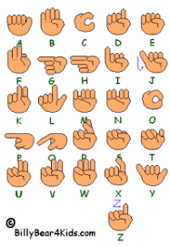
Corpora of
Sign Language

Slide 11
corpus-based Vs corpus-driven
Linguistics

Slide 12
Corpura
Corpus-based
- Studies typically use corpus data to explore a theory or hypothesis, typically one established in the current literature, to confirm it, refute it or reﬁne it.
- The deﬁnition of corpus linguistics as a method support this approach to the use of corpus data in linguistics.
Corpus-driven
- Linguistics rejects the characterization of corpus linguistics as a method and claims instead that the corpus itself should be the sole source of our hypotheses about language.
- It is thus claimed that the corpus itself embodies its own theory of language.

Slide 13
Data collection regimes
Monitor Corpora
The Web as Corpus
Balanced Corpora
The Sample Corpus Approach
Opportunistic Corpora

Slide 14
Monitor Corpora
A monitor corpus is a dataset which grows in size over time and contains a variety of materials.
The relative proportions of different types of materials may vary over time.

Slide 15
Web as corpus
The standard example is using search engines such as Google to explore the web as a corpus.
But many texts on the web contain errors of all sorts. For example:

Slide 16
Balanced Corpora
Balanced corpora, in contrast to monitor corpora and also known as sample corpora, try to represent a particular type of language over a specific span of time. In doing so they seek to be balanced and representative within a particular sampling frame.

Slide 17
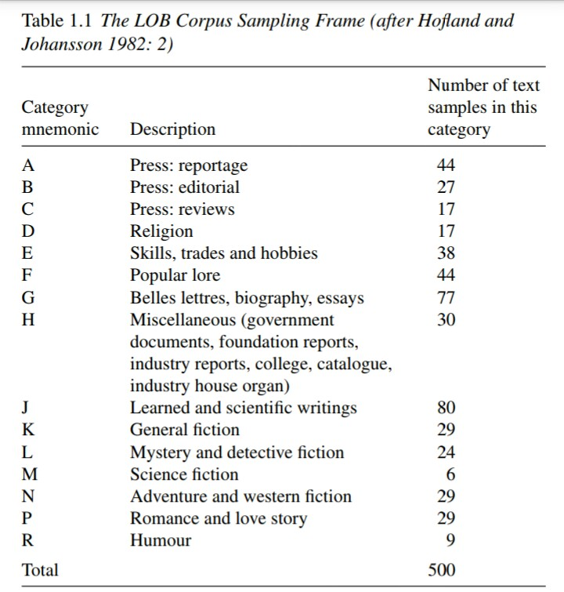

Slide 18
Opportunistic Corpora
Opportunistic Corpora is not match the description of either a monitor or a sample corpus. These corpora do not adhere to a rigorous sampling frame. They represent nothing more nor less than the data that it was possible to gather for a specific task. Today, an opportunistic approach is often needed with spoken data in particular: converting spoken recordings into machine-readable transcriptions is a very time consuming task.

Slide 19
The general division of language
Official majority languages
Unofficial languages
Endangered languages
Official minority languages
Official languages are better supplied with corpus data than other for a range of non-linguistic reason.

Slide 20
Annotated vs unannotated corpora

Slide 21
Annotated corpora
Linguistic analyses encoded in the corpus data itself are usually called corpus annotation.
- We may wish to annotate a corpus to show parts of speech, assigning to each word a grammatical category label.
- So when we see the word talk in the sentence I heard John's talk and it was the same old thing, we would assign it the category noun in that context. This would often be done using some mnemonic code or tag such as N.

Slide 22
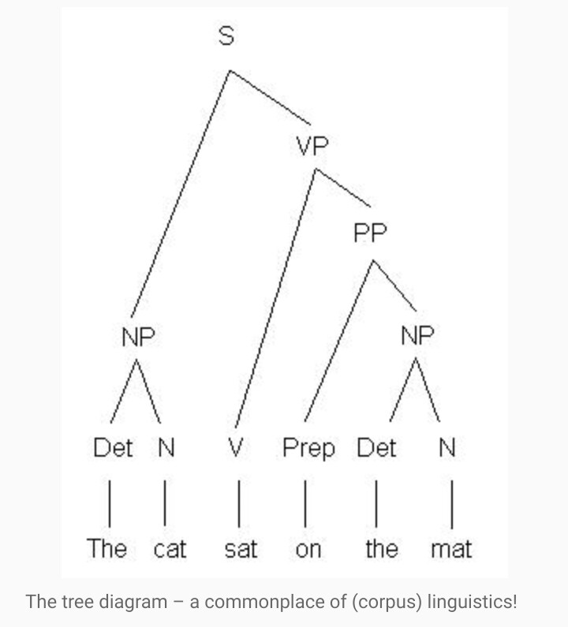

Slide 23
Total accountability vs data selection

Slide 24
Total accountability vs data selection
Total accountability
Falsifiability
Replicability
Data selection
Not necessarily a bad thing

Slide 25
Monolingual vs multilingual corpora

Slide 26
Monolingual vs multilingual
Many corpora are monolingual – they contain data in only one language.
There are two types of multilingual corpora:
Comparable corpora
Parallel corpora

Slide 27
Multilingual corpora
Comparable Corpus
contains components in two or more languages that have been collected using the same sampling method, e.g. the same proportions of the texts of the same genres in the same domains in a range of different languages in the same sampling period. The sub corpora of a comparable corpus are not translations of each other.
Parallel Corpus
contains native language source texts and their translations. In this case, the sampling frame is automatically the same for all the languages in the corpus.

